Slide 1
Design and Analysis of Algorithms
Shortest Paths II (Ch24)

Slide 2
Design and Analysis of Algorithms
Shortest Paths II
Topics:
Bellman-Ford algorithm

Slide 3
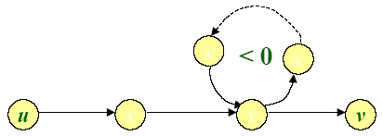
Negative-weight cycles
Recall: If a graph G=(V,E) contains a negative-weight cycle, then some shortest paths may not exist.
Example:
Bellman-Ford algorithm: Finds all shortest-path lengths from a source s∈V to v∈V or determines that negative-weight cycle exists.

Slide 4
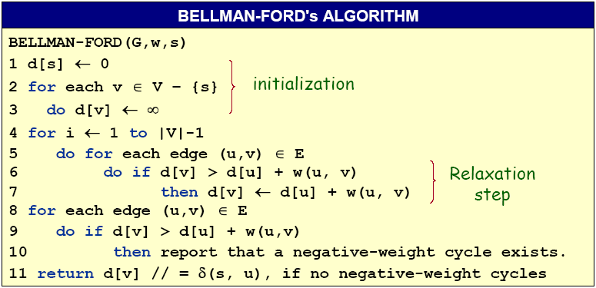
Bellman-Ford algorithm
Time=O(VE)

Slide 5
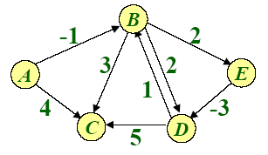
Example of Bellman-Ford

Slide 6
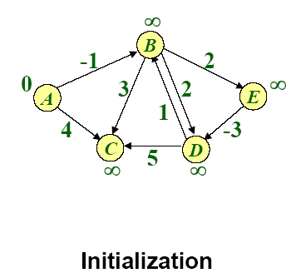
Example of Bellman-Ford

Slide 7
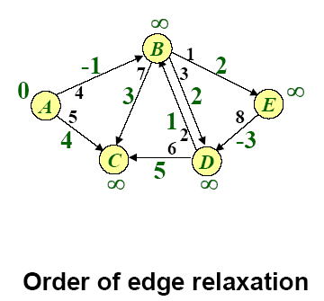
Example of Bellman-Ford

Slide 8
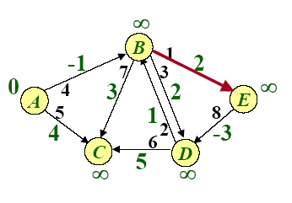
Example of Bellman-Ford

Slide 9
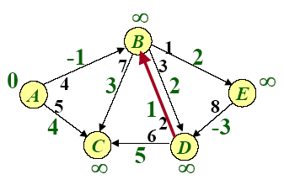
Example of Bellman-Ford

Slide 10
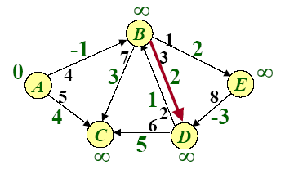
Example of Bellman-Ford

Slide 11
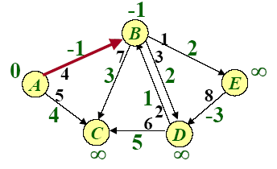
Example of Bellman-Ford

Slide 12
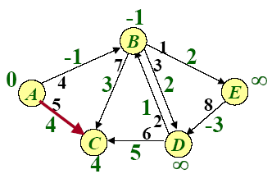
Example of Bellman-Ford

Slide 13
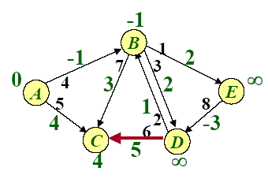
Example of Bellman-Ford

Slide 14
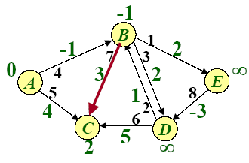
Example of Bellman-Ford

Slide 15
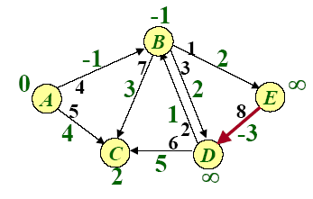
Example of Bellman-Ford

Slide 16
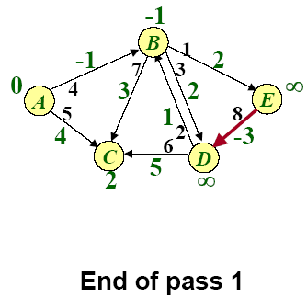
Example of Bellman-Ford

Slide 17
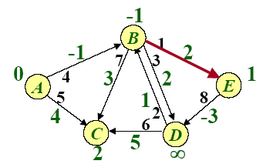
Example of Bellman-Ford

Slide 18
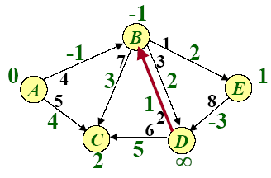
Example of Bellman-Ford

Slide 19
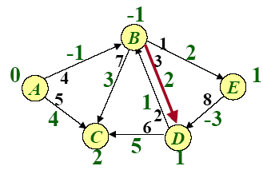
Example of Bellman-Ford

Slide 20
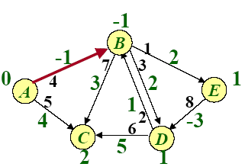
Example of Bellman-Ford

Slide 21
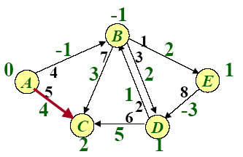
Example of Bellman-Ford

Slide 22
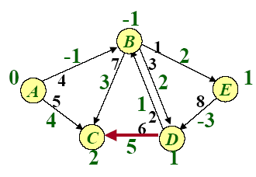
Example of Bellman-Ford

Slide 23
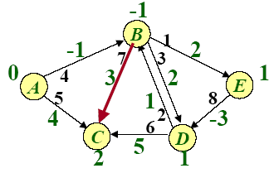
Example of Bellman-Ford

Slide 24
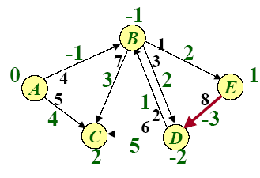
Example of Bellman-Ford

Slide 25
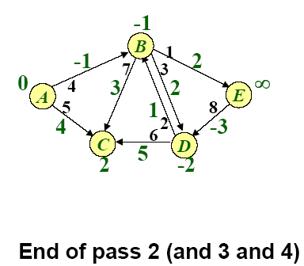
Example of Bellman-Ford

Slide 26
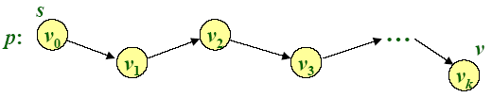
Correctness
Theorem. If G=(V,E) contains no negative-weight cycles, then after the Bellman-Ford algorithm executes, d[v]=δ(s,v) for all v∈V
Proof. Let v ∈V be any vertex, and consider a shortest path p from s to v with the minimum number of edges.
Since p is a shortest path, we have
δ(s,v_{i})=δ(s,v_{i-1})+w(v_{i-1},v_{i})

Slide 27
Correctness (continued)
Initially, d[v₀]=0=δ(s,v₀) and d[v₀] is unchanged by subsequent relaxations (because of the lemma from previous Lecture that d[v] ≥δ(s,v))
-- After 1 path through E, we have d[v₁]= δ(s,v₁)
-- After 2 path through E, we have d[v₂]= δ(s,v₂)
--…
-- After k path through E, we have d[v_{k}]= δ(s,v_{k})
Since G contains no negative-weight cycles, p is simple.
Longest simple path has ≤|V|-1 edges.□

Slide 28
Detection of negative-weight cycles
Corollary. If a value d[v] fails to converge after |V|-1 passes, there exists a negative-weight cycle in G reachable from s.□

Slide 29
Bellman-Ford algorithm
Time=O(VE)

Slide 30
Homework
24.1-1

